Slide 1
Bayesian Model Selection: Testing and selecting model in a systematic way
SA AIMS
18th Feb, 2026
Lloyd Fung
Research Fellow
Imperial College London

Slide 2

Occam Razor / Principle of parsimony
“When faced with two (or more) possible explanations, the simpler one is the one most likely to be true.”
(Paraphrasing) William of Ockham

Slide 3
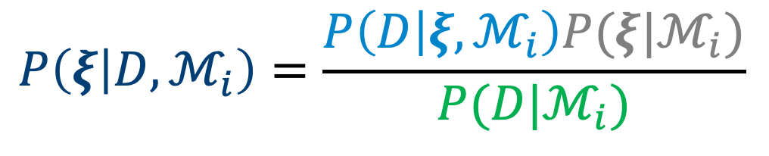



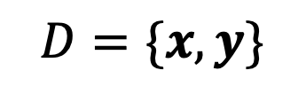

Bayes’ Theorem
likelihood
prior
$$P\left(ξ | D,ℳ_{i}\right)=\frac{P\left(D | ξ,ℳ_{i}\right)P(ξ|ℳ_{i})}{P(D|ℳ_{i})}$$
posterior
Difficult to eval. in high dimension!
evidence
Model selection under Bayes
$$D=\{x,y\}$$
Data
$$\underset{ℳ_{i}}{argmax}{P(ℳ_{i}|D)}$$
$$ℳ_{i}$$
Hypothesis (model basis)
where
$$ξ$$
Fitting parameters
$$P(ℳ_{i}|D)∝P\left(D | ℳ_{i}\right)P(ℳ_{i})$$
Notes:
The challenge:

Slide 4


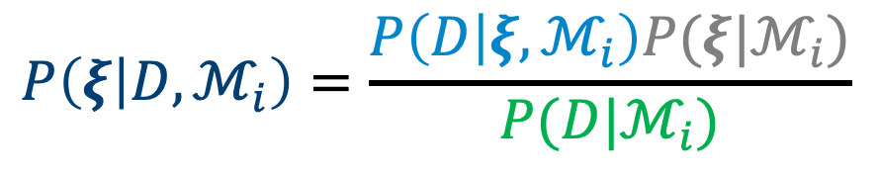

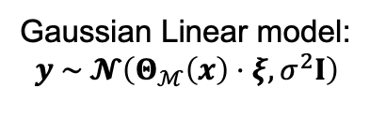

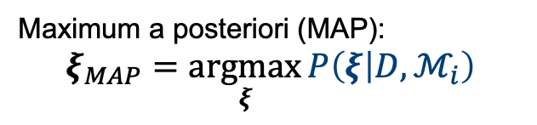
Why is max. evidence = Occam Razor? An example with linear regression
$D=\{x,y\}$
Data
$ℳ_{i}$
Model
likelihood
prior
Bayes’ rule
$Θ_{ℳ}\left(x\right)$
Model Basis
$$P\left(ξ | D,ℳ_{i}\right)=\frac{P\left(D | ξ,ℳ_{i}\right)P(ξ|ℳ_{i})}{P(D|ℳ_{i})}$$
$ξ$
Fitting parameters
posterior
evidence
Gaussian Linear model:
$$y \sim 𝓝\left(Θ_{ℳ}\left(x\right)⋅ξ,σ^{2}I\right)$$
error
$$−\ln{P\left(ξ | D,ℳ_{i}\right)}=\frac{1}{2σ^{2}}{\left\|y−Θ_{ℳ}\left(x\right)⋅ξ\right\|}_{F}^{2}+\frac{1}{2σ_{p}^{2}}{\left\|ξ\right\|}_{2}^{2}+normalise$$
posterior
likelihood
Prior (L₂ regularisation)
Maximum a posteriori (MAP):
$$ξ_{MAP}=\underset{ξ}{argmax}{P\left(ξ | D,ℳ_{i}\right)}$$
Regularised Regression (Regularisation ↔ prior)
Notes:
Usually, the computation of Bayesian statistic would involve some very expensive sampling. In particular, the computation of evidence involve marginalising the whole parameter space, which is very expensive. Instead, in this work, we are going to a regression-based approach to the whole computation.
To turn this into a regression problem, all we have to do is to the negative log of the Bayes Rule, which if the noise model for the data is not too terribly complicated, like for example, if the measurement noise is just Gaussian, which is what those error bar represents, what comes out is practically the same as the loss function of your usual least square regression. Meanwhile, the prior will give you the regularisation. For example, a Gaussian prior would be equivalent to having a L2 norm in the regularisation, or ridge regression.
So if I do a regression on this problem, the parameter value I would be find would be equivalent to the Maximum a Posteriori

Slide 5
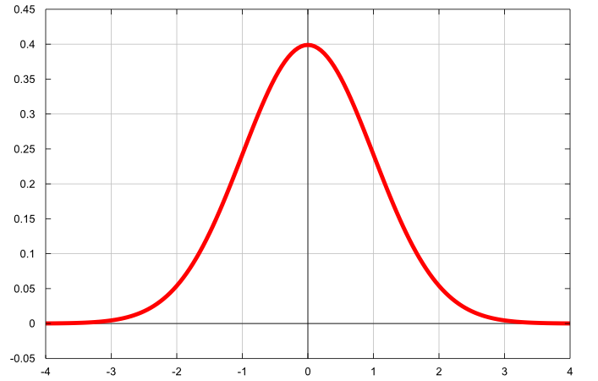

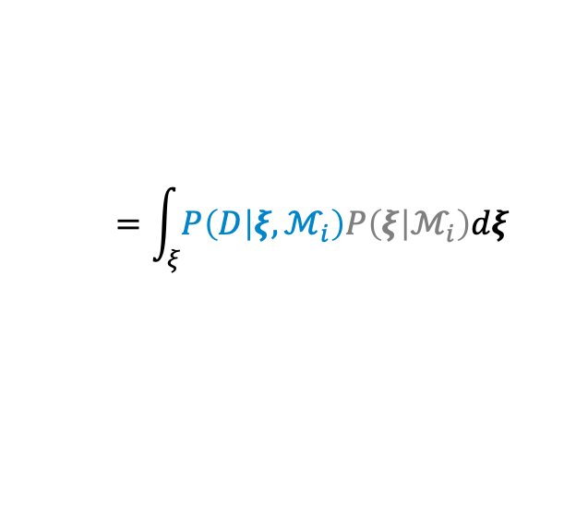







Why is max. evidence = Occam Razor? An example with linear regression
$$A=σ_{p}^{−2}I+σ_{}^{−2}{Θ_{ℳ}}^{T}Θ_{ℳ}$$
Assuming the prior to all models ${P(ℳ}_{i})$ is uniform:
$$=\int_{ξ}{P\left(D | ξ,ℳ_{i}\right)P\left(ξ | ℳ_{i}\right)dξ}$$
$$P\left(ℳ_{i} | D\right)∝P\left(D | ℳ_{i}\right)$$
Difficult to eval.
Posterior:
$$P\left(D | ξ_{MAP} \right)P\left(ξ_{MAP}\right)$$
$$A$$
$$D=\{x,y\}$$
Data
$$ℳ_{i}$$
Model
$$ξ$$
Fitting parameters
$$A$$
Parameter Covariance
Notes:
But the regression not gives us the MAP point, it also gives us the uncertainty of the parameter, or the parameter covariance, which we are going to use to compute the evidence by a Laplace approximation.
If we assume a Gaussian likelihood and prior, it also happens that the matrix is exactly the one you'd invert to get the MAP approximation to your parameter. So, at almost no extra computational cost, you can obtain an approximation of the evidence, which you can then use to compare different models and select the most parsimonious.
Now, here's an important point. The maximum posterior probability, which tells you how well the model fits the data, scales with the number of data. The covariance contribution to the evidence, which penalises models with too many parameters or with parameters too uncertain, scales with the number of terms in your model. This means that if you have a lot of data with low noise, the relative contribution of the last term is small. This is why vanilla SINDy works well in those data regimes. However, if the number of data is of similar order as the number of basis functions in your model or if the noise in the data is large, then the uncertainty in parameters plays an important role. This is why we expect the Bayesian framework, which accounts for this contribution, to work better than the ordinary SINDy when the data environment is difficult.

Slide 6

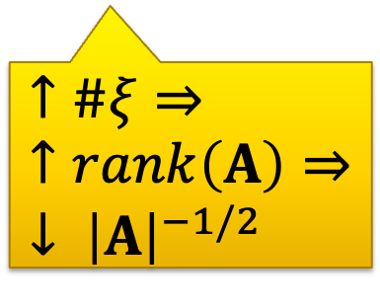
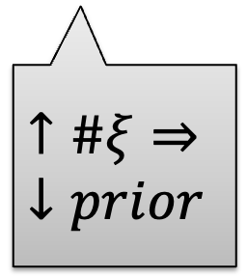

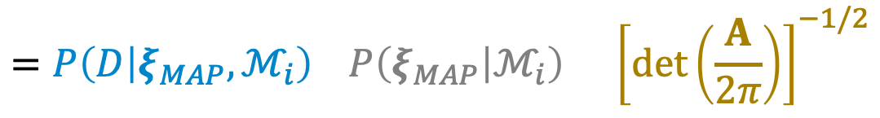
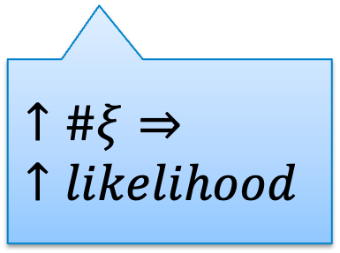

Why is max. evidence = Occam Razor? An example with linear regression
$$A=σ_{p}^{−2}I+σ_{}^{−2}{Θ_{ℳ}}^{T}Θ_{ℳ}$$
Assuming the prior to all models ${P(ℳ}_{i})$ is uniform:
Occam Razor!
$$=\int_{ξ}{P\left(D | ξ,ℳ_{i}\right)P\left(ξ | ℳ_{i}\right)dξ}$$
$$P\left(ℳ_{i} | D\right)∝P\left(D | ℳ_{i}\right)$$
$$=P\left(D | ξ_{MAP},ℳ_{i}\right) P\left(ξ_{MAP} | ℳ_{i}\right) {\left[\det\left(\frac{A}{2π}\right)\right]}^{−1/2}$$
Posterior:
$$P\left(D | ξ_{MAP} \right)P\left(ξ_{MAP}\right)$$
Likelihood @ MAP
Prior on $ξ$ @ MAP
Uncertainty in $ξ$ around MAP
$$A$$
$$↑\#ξ⇒ ↑likelihood$$
$$↑\#ξ⇒ ↓prior$$
$$↑\#ξ⇒↑rank\left(A\right)⇒↓ {\left|A\right|}^{−1/2}$$
$$D=\{x,y\}$$
Data
$$ℳ_{i}$$
Model
$$ξ$$
Fitting parameters
$$A$$
Parameter Covariance
How well $ℳ_{i}$ fit
Penal models with too many param.
Notes:
But the regression not gives us the MAP point, it also gives us the uncertainty of the parameter, or the parameter covariance, which we are going to use to compute the evidence by a Laplace approximation.
If we assume a Gaussian likelihood and prior, it also happens that the matrix is exactly the one you'd invert to get the MAP approximation to your parameter. So, at almost no extra computational cost, you can obtain an approximation of the evidence, which you can then use to compare different models and select the most parsimonious.
Now, here's an important point. The maximum posterior probability, which tells you how well the model fits the data, scales with the number of data. The covariance contribution to the evidence, which penalises models with too many parameters or with parameters too uncertain, scales with the number of terms in your model. This means that if you have a lot of data with low noise, the relative contribution of the last term is small. This is why vanilla SINDy works well in those data regimes. However, if the number of data is of similar order as the number of basis functions in your model or if the noise in the data is large, then the uncertainty in parameters plays an important role. This is why we expect the Bayesian framework, which accounts for this contribution, to work better than the ordinary SINDy when the data environment is difficult.

Slide 7
Most parsimonious model
Model with max. evidence

Slide 8

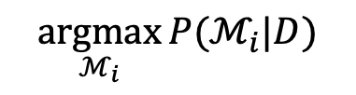






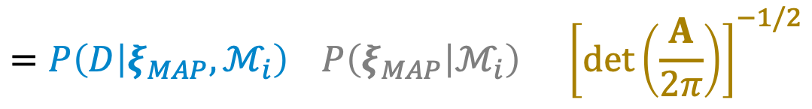
Computing Evidence – Gaussian case
Aim:
$$\underset{ℳ_{i}}{argmax}{P(ℳ_{i}|D)}$$
$$=\int_{ξ}{P\left(D | ξ,ℳ_{i}\right)P\left(ξ | ℳ_{i}\right)dξ}$$
$$P\left(ℳ_{i} | D\right)∝P\left(D | ℳ_{i}\right)$$
$$=P\left(D | ξ_{MAP},ℳ_{i}\right) P\left(ξ_{MAP} | ℳ_{i}\right) {\left[\det\left(\frac{A}{2π}\right)\right]}^{−1/2}$$
Likelihood @ MAP
Prior on $ξ$ @ MAP
Uncertainty in $ξ$ around MAP
Obtained from linear regression
Occam Factor
Posterior:
$$P\left(D | ξ_{MAP} \right)P\left(ξ_{MAP}\right)$$
Penalizes models with too many param.
$$D=\{x,y\}$$
Data
$$A$$
$$ℳ_{i}$$
Model
$$ξ$$
Fitting parameters
$$A=σ_{p}^{−2}I+σ_{}^{−2}{Θ_{ℳ}}^{T}Θ_{ℳ}$$
$$A$$
Parameter Covariance
Notes:
But the regression not gives us the MAP point, it also gives us the uncertainty of the parameter, or the parameter covariance, which we are going to use to compute the evidence by a Laplace approximation.
If we assume a Gaussian likelihood and prior, it also happens that the matrix is exactly the one you'd invert to get the MAP approximation to your parameter. So, at almost no extra computational cost, you can obtain an approximation of the evidence, which you can then use to compare different models and select the most parsimonious.
Now, here's an important point. The maximum posterior probability, which tells you how well the model fits the data, scales with the number of data. The covariance contribution to the evidence, which penalises models with too many parameters or with parameters too uncertain, scales with the number of terms in your model. This means that if you have a lot of data with low noise, the relative contribution of the last term is small. This is why vanilla SINDy works well in those data regimes. However, if the number of data is of similar order as the number of basis functions in your model or if the noise in the data is large, then the uncertainty in parameters plays an important role. This is why we expect the Bayesian framework, which accounts for this contribution, to work better than the ordinary SINDy when the data environment is difficult.

Slide 9
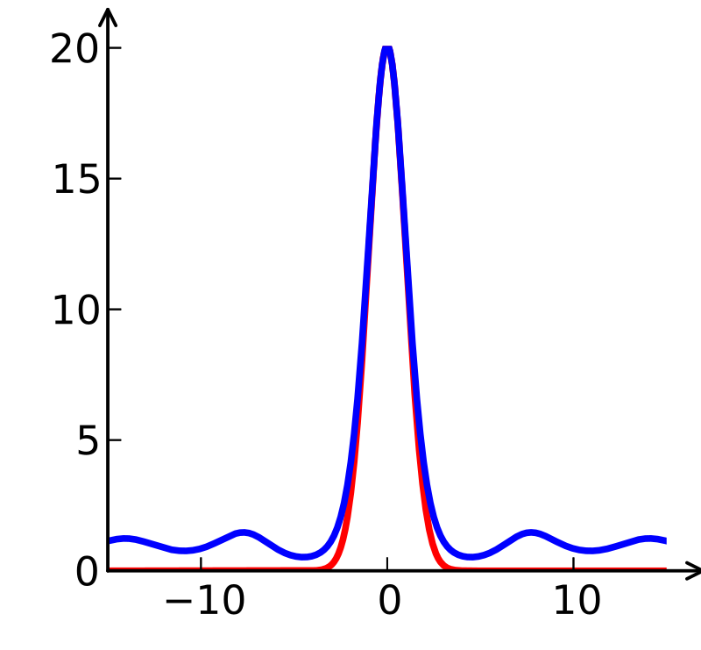




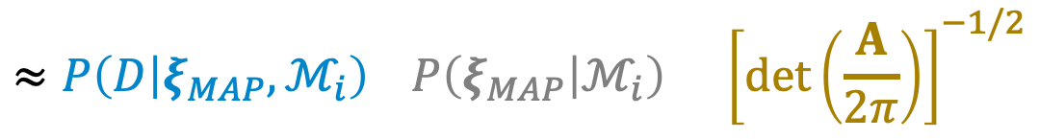

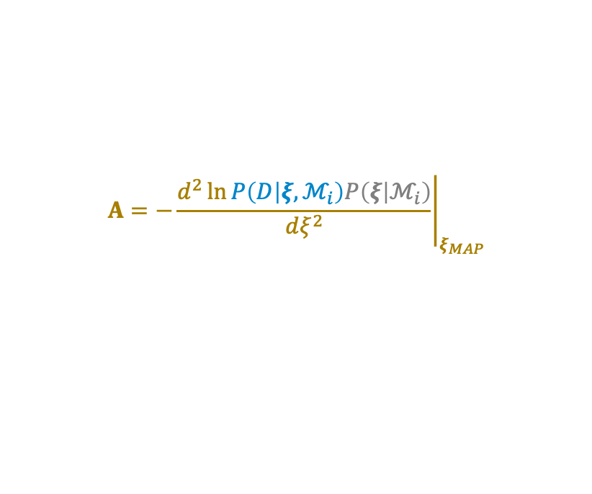
Approximating Evidence – Laplace Method
Aim:
$$\underset{ℳ_{i}}{argmax}{P(ℳ_{i}|D)}$$
$$=\int_{ξ}{P\left(D | ξ,ℳ_{i}\right)P\left(ξ | ℳ_{i}\right)dξ}$$
$$P\left(ℳ_{i} | D\right)∝P\left(D | ℳ_{i}\right)$$
$$∝P\left(ξ | D\right)$$
$$≈P\left(D | ξ_{MAP},ℳ_{i}\right) P\left(ξ_{MAP} | ℳ_{i}\right) {\left[\det\left(\frac{A}{2π}\right)\right]}^{−1/2}$$
Difficult to eval.
Likelihood @ MAP
Prior on $ξ$ @ MAP
Uncertainty in $ξ$ around MAP
Obtained from variational inference
Posterior:
Occam Factor
$$P\left(D | ξ_{MAP} \right)P\left(ξ_{MAP}\right)$$
Penalizes models with too many param.
$$D=\{x,y\}$$
Data
$$ℳ_{i}$$
Model
$$A=−{\left.\frac{d^{2}\ln{P\left(D | ξ,ℳ_{i}\right)P\left(ξ | ℳ_{i}\right)}}{dξ^{2}}\right|}_{ξ_{MAP}}$$
$$ξ$$
Fitting parameters
$$A$$
$$A$$
Parameter Uncertainty
Notes:
But the regression not gives us the MAP point, it also gives us the uncertainty of the parameter, or the parameter covariance, which we are going to use to compute the evidence by a Laplace approximation.
If we assume a Gaussian likelihood and prior, it also happens that the matrix is exactly the one you'd invert to get the MAP approximation to your parameter. So, at almost no extra computational cost, you can obtain an approximation of the evidence, which you can then use to compare different models and select the most parsimonious.
Now, here's an important point. The maximum posterior probability, which tells you how well the model fits the data, scales with the number of data. The covariance contribution to the evidence, which penalises models with too many parameters or with parameters too uncertain, scales with the number of terms in your model. This means that if you have a lot of data with low noise, the relative contribution of the last term is small. This is why vanilla SINDy works well in those data regimes. However, if the number of data is of similar order as the number of basis functions in your model or if the noise in the data is large, then the uncertainty in parameters plays an important role. This is why we expect the Bayesian framework, which accounts for this contribution, to work better than the ordinary SINDy when the data environment is difficult.

Slide 10
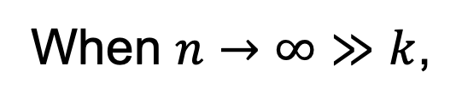


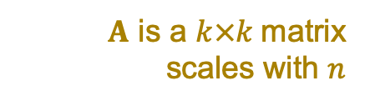





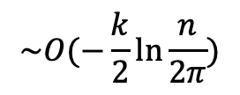


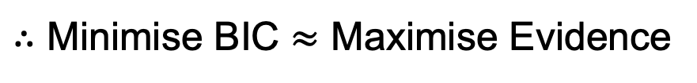

Scaling of Likelihood and Occam Factor and BIC
$A$ is a $k×k$matrix scales with $n$
$$ln P\left(D | ℳ_{i}\right)≈ln P\left(D | ξ_{MAP},ℳ_{i}\right)+ln P\left(ξ_{MAP} | ℳ_{i}\right)+ln{\left[\det\left(\frac{A}{2π}\right)\right]}^{−1/2}$$
$$\sim O(n)$$
$$\sim O(k)$$
$$\sim O(−\frac{k}{2}\ln{\frac{n}{2π}})$$
Likelihood @ MAP
$$\sim O(n)$$
Occam Factor
$$\sim O(k)$$
When $n→∞≫k$,
$$n$$
Number of data
$$−2 ln P\left(D | ℳ_{i}\right)≈−2 ln \hat{L}+k\ln{n}+O(1)$$
$$k$$
Number of parameters
$$D$$
Data
$$BIC=k\ln{n−2 ln \hat{L}}$$
$$ℳ_{i}$$
Model
$$ξ$$
Fitting parameters
$∴$ Minimise BIC $≈$ Maximise Evidence
$$A$$
Parameter Covariance
Notes:
But the regression not gives us the MAP point, it also gives us the uncertainty of the parameter, or the parameter covariance, which we are going to use to compute the evidence by a Laplace approximation.
If we assume a Gaussian likelihood and prior, it also happens that the matrix is exactly the one you'd invert to get the MAP approximation to your parameter. So, at almost no extra computational cost, you can obtain an approximation of the evidence, which you can then use to compare different models and select the most parsimonious.
Now, here's an important point. The maximum posterior probability, which tells you how well the model fits the data, scales with the number of data. The covariance contribution to the evidence, which penalises models with too many parameters or with parameters too uncertain, scales with the number of terms in your model. This means that if you have a lot of data with low noise, the relative contribution of the last term is small. This is why vanilla SINDy works well in those data regimes. However, if the number of data is of similar order as the number of basis functions in your model or if the noise in the data is large, then the uncertainty in parameters plays an important role. This is why we expect the Bayesian framework, which accounts for this contribution, to work better than the ordinary SINDy when the data environment is difficult.

Slide 11


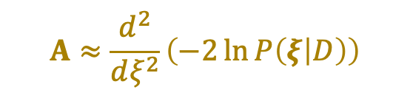


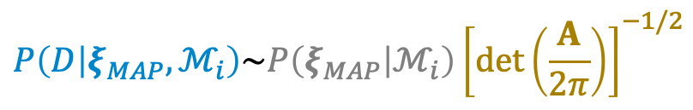
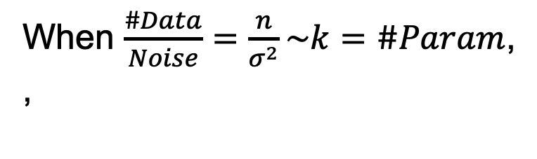

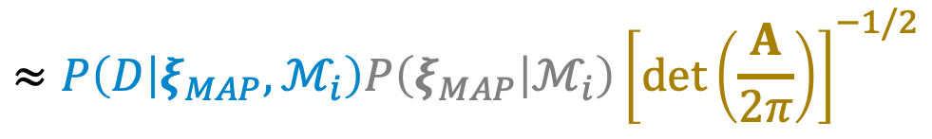


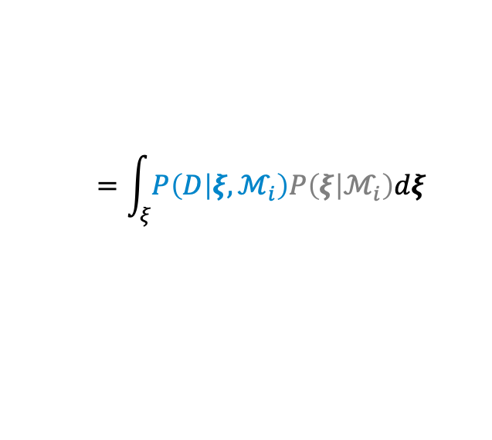
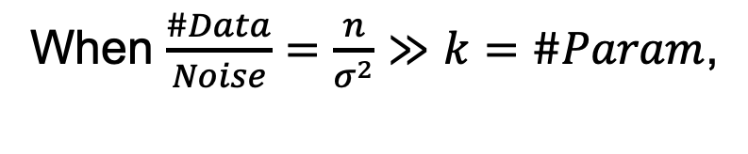
Scaling of Likelihood and Occam Factor
Aim:
$$\underset{ℳ_{i}}{argmax}{P(ℳ_{i}|D)}$$
Assuming the prior to all models ${P(ℳ}_{i})$ is uniform:
$$=\int_{ξ}{P\left(D | ξ,ℳ_{i}\right)P\left(ξ | ℳ_{i}\right)dξ}$$
$$A≈\frac{d^{2}}{dξ^{2}}\left(−2\ln{P\left(ξ | D\right)}\right)$$
$$P\left(ℳ_{i} | D\right)∝P\left(D | ℳ_{i}\right)$$
(approximating by Laplace method)
Prior: $ξ$ magnitude
Uncertainty in $ξ$
$$≈P\left(D | ξ_{MAP},ℳ_{i}\right)P\left(ξ_{MAP} | ℳ_{i}\right){\left[\det\left(\frac{A}{2π}\right)\right]}^{−1/2}$$
Penalizes models with too many param.
Obtained from linear regression
Likelihood @ MAP
Occam Factor
$$\sim exp(\#Data/Noise)$$
$$\sim exp(\#Param)$$
When $\frac{\#Data}{Noise}=\frac{n}{σ^{2}}≫k=\#Param$,
$$D=\{x,\dot{x}\}$$
Data
$$P\left(D | ξ_{MAP},ℳ_{i}\right)≈P\left(D | ℳ_{i}\right)$$
$$ℳ_{i}$$
Model
When $\frac{\#Data}{Noise}=\frac{n}{σ^{2}}\sim k=\#Param$, ,
$$ξ$$
Fitting parameters
$$P\left(D | ξ_{MAP},ℳ_{i}\right)\sim P\left(ξ_{MAP} | ℳ_{i}\right){\left[\det\left(\frac{A}{2π}\right)\right]}^{−1/2}$$
$$A$$
Parameter Covariance
Notes:
But the regression not gives us the MAP point, it also gives us the uncertainty of the parameter, or the parameter covariance, which we are going to use to compute the evidence by a Laplace approximation.
If we assume a Gaussian likelihood and prior, it also happens that the matrix is exactly the one you'd invert to get the MAP approximation to your parameter. So, at almost no extra computational cost, you can obtain an approximation of the evidence, which you can then use to compare different models and select the most parsimonious.
Now, here's an important point. The maximum posterior probability, which tells you how well the model fits the data, scales with the number of data. The covariance contribution to the evidence, which penalises models with too many parameters or with parameters too uncertain, scales with the number of terms in your model. This means that if you have a lot of data with low noise, the relative contribution of the last term is small. This is why vanilla SINDy works well in those data regimes. However, if the number of data is of similar order as the number of basis functions in your model or if the noise in the data is large, then the uncertainty in parameters plays an important role. This is why we expect the Bayesian framework, which accounts for this contribution, to work better than the ordinary SINDy when the data environment is difficult.

Slide 12


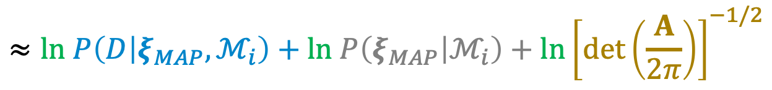








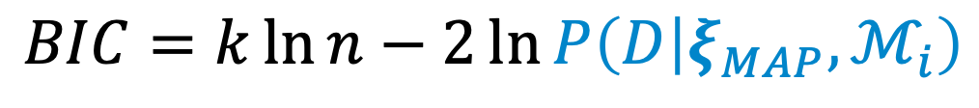

Side note: How does Bayesian Information Criterion (BIC) come about?
$$BIC=k\ln{n}−2\ln{P\left(D | ξ_{MAP},ℳ_{i}\right)}$$
Minimise this.
$$A≈\frac{d^{2}}{dξ^{2}}\left(−2\ln{P\left(ξ | D\right)}\right)$$
$$\#Param$$
$$\#Data$$
$$≈ln P\left(D | ξ_{MAP},ℳ_{i}\right)+ln P\left(ξ_{MAP} | ℳ_{i}\right)+ln{\left[\det\left(\frac{A}{2π}\right)\right]}^{−1/2}$$
$$ln P\left(D | ℳ_{i}\right)$$
$$\sim O(n)$$
$$\sim O(k)$$
$$\sim O(−\frac{k}{2}\ln{\frac{n}{2π}})$$
$$\sim O(\#Basis)$$
Let $n=\#Data$,
Prior on $ξ$ @ MAP
Uncertainty in $ξ$ around MAP
$$D=\{x,\dot{x}\}$$
Likelihood @ MAP
Data
Occam Factor
$$ℳ_{i}$$
Model
$$ξ$$
Fitting parameters
$$A$$
Parameter Covariance
Notes:
But the regression not gives us the MAP point, it also gives us the uncertainty of the parameter, or the parameter covariance, which we are going to use to compute the evidence by a Laplace approximation.
If we assume a Gaussian likelihood and prior, it also happens that the matrix is exactly the one you'd invert to get the MAP approximation to your parameter. So, at almost no extra computational cost, you can obtain an approximation of the evidence, which you can then use to compare different models and select the most parsimonious.
Now, here's an important point. The maximum posterior probability, which tells you how well the model fits the data, scales with the number of data. The covariance contribution to the evidence, which penalises models with too many parameters or with parameters too uncertain, scales with the number of terms in your model. This means that if you have a lot of data with low noise, the relative contribution of the last term is small. This is why vanilla SINDy works well in those data regimes. However, if the number of data is of similar order as the number of basis functions in your model or if the noise in the data is large, then the uncertainty in parameters plays an important role. This is why we expect the Bayesian framework, which accounts for this contribution, to work better than the ordinary SINDy when the data environment is difficult.

Slide 13
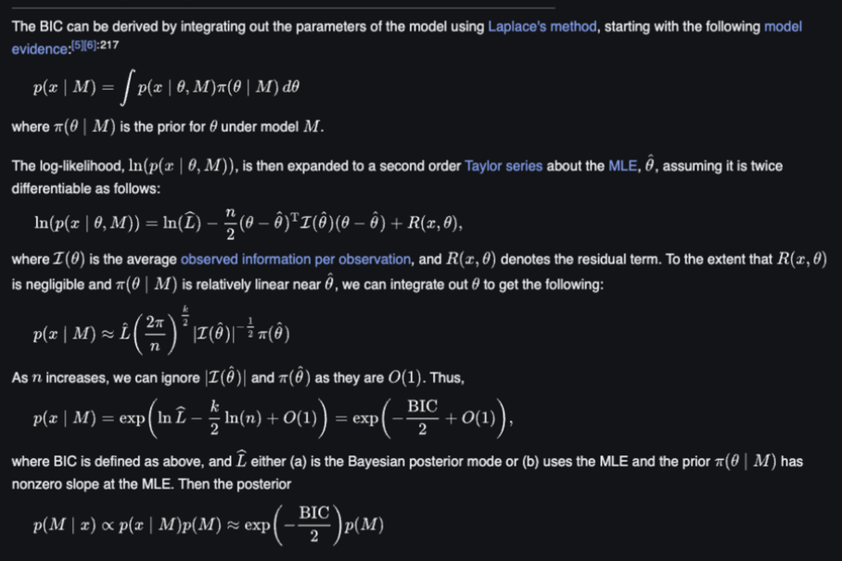
Side note: How does BIC come about?

Slide 14
Model Sparsification
Selecting a model in a set of models defined by combinations of terms

Slide 15
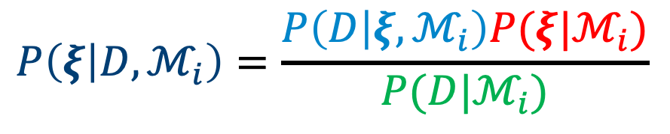
The Role of Prior in Regression
$D=\{x,y\}$
Data
$ℳ_{i}$
Model
likelihood
prior
Bayes’ rule
$Θ_{ℳ}\left(x\right)$
Model Basis
$$P\left(ξ | D,ℳ_{i}\right)=\frac{P\left(D | ξ,ℳ_{i}\right)P(ξ|ℳ_{i})}{P(D|ℳ_{i})}$$
$ξ$
Fitting parameters
posterior
evidence
Gaussian Linear model:
$$y \sim 𝓝\left(Θ_{ℳ}\left(x\right)⋅ξ,σ^{2}I\right)$$
error
$$−\ln{P\left(ξ | D,ℳ_{i}\right)}=\frac{1}{2σ^{2}}{\left\|y−Θ_{ℳ}\left(x\right)⋅ξ\right\|}_{F}^{2}+{γ\left\|ξ\right\|}_{}^{}+normalise$$
posterior
likelihood
Prior (Regularisation)
Maximum a posteriori (MAP):
$$ξ_{MAP}=\underset{ξ}{argmax}{P\left(ξ | D,ℳ_{i}\right)}$$
Regularised Regression (Regularisation ↔ prior)
Notes:
Usually, the computation of Bayesian statistic would involve some very expensive sampling. In particular, the computation of evidence involve marginalising the whole parameter space, which is very expensive. Instead, in this work, we are going to a regression-based approach to the whole computation.
To turn this into a regression problem, all we have to do is to the negative log of the Bayes Rule, which if the noise model for the data is not too terribly complicated, like for example, if the measurement noise is just Gaussian, which is what those error bar represents, what comes out is practically the same as the loss function of your usual least square regression. Meanwhile, the prior will give you the regularisation. For example, a Gaussian prior would be equivalent to having a L2 norm in the regularisation, or ridge regression.
So if I do a regression on this problem, the parameter value I would be find would be equivalent to the Maximum a Posteriori

Slide 16
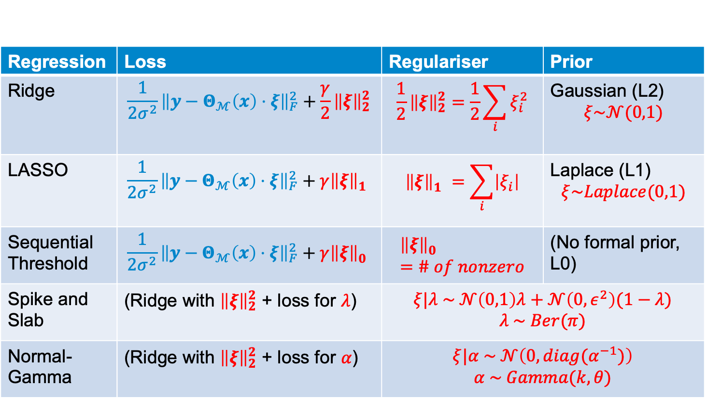
Types of prior
Regression | Loss | Regulariser | Prior
Ridge | $$\frac{1}{2σ^{2}}{\left\|y−Θ_{ℳ}\left(x\right)⋅ξ\right\|}_{F}^{2}+\frac{γ}{2}{\left\|ξ\right\|}_{2}^{2}$$ | $$\frac{1}{2}{\left\|ξ\right\|}_{2}^{2}=\frac{1}{2}\sum_{i}{ξ_{i}^{2}}$$ | Gaussian (L2) $$ξ\sim 𝒩(0,1)$$
LASSO | $$\frac{1}{2σ^{2}}{\left\|y−Θ_{ℳ}\left(x\right)⋅ξ\right\|}_{F}^{2}+γ{\left\|ξ\right\|}_{1}^{}$$ | $${\left\|ξ\right\|}_{1}^{}=\sum_{i}{\left|ξ_{i}\right|}$$ | Laplace (L1) $$ξ\sim Laplace(0,1)$$
Sequential Threshold | $$\frac{1}{2σ^{2}}{\left\|y−Θ_{ℳ}\left(x\right)⋅ξ\right\|}_{F}^{2}+γ{\left\|ξ\right\|}_{0}^{}$$ | $${\left\|ξ\right\|}_{0}^{}=\# of nonzero$$ | (No formal prior, L0)
Spike and Slab | (Ridge with ${\left\|ξ\right\|}_{2}^{2}$ + loss for $λ$) | $$ξ|λ \sim 𝒩\left(0,1\right)λ+𝒩\left(0,ε^{2}\right)(1−λ)$$ $$λ \sim Ber(π)$$
Normal-Gamma | (Ridge with ${\left\|ξ\right\|}_{2}^{2}$ + loss for $α$) | $$ξ|α \sim 𝒩\left(0,{diag(α}^{−1})\right)$$ $$α \sim Gamma(k,θ)$$

Slide 17
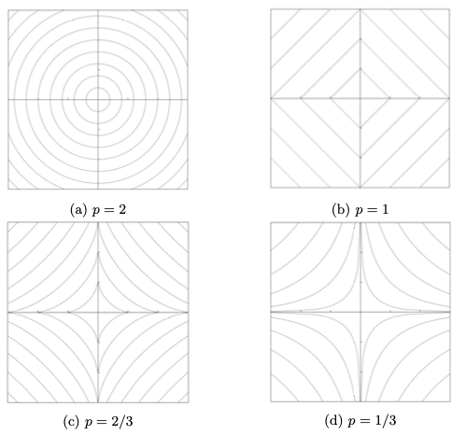
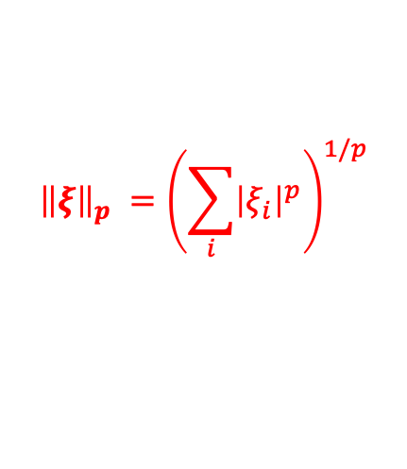


Prior as sparsifier
$${\left\|ξ\right\|}_{p}^{}={\left(\sum_{i}{{\left|ξ_{i}\right|}^{p}}\right)}^{1/p}$$
$$ξ_{2}$$
likelihood
$$ξ_{1}$$
L₂ Prior (Regularisation)

Slide 18
Prior as sparsifier
$${\left\|ξ\right\|}_{p}^{}={\left(\sum_{i}{{\left|ξ_{i}\right|}^{p}}\right)}^{1/p}$$
$$ξ_{2}$$
likelihood
$$ξ_{1}$$
L₁ Prior (Regularisation)

Slide 19
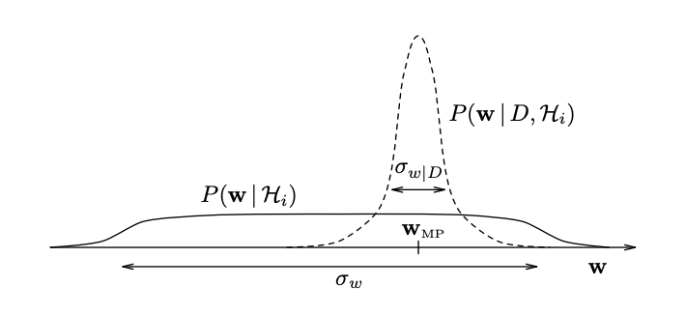
Prior as sparsifier – Hierarchical Prior
Posterior:
Prior:

Slide 20

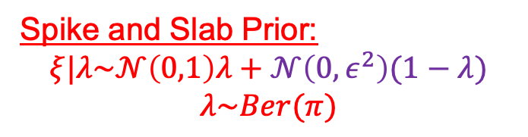
Prior as sparsifier – Hierarchical Prior
Spike and Slab Prior:
$$ξ|λ\sim 𝒩\left(0,1\right)λ+𝒩\left(0,ε^{2}\right)(1−λ)$$
$$λ\sim Ber(π)$$
Prior 2
Prior 1
0
$$ξ_{1}$$

Slide 21

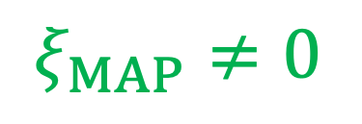

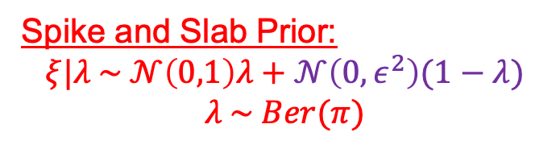
Prior as sparsifier – Hierarchical Prior
Spike and Slab Prior:
$$ξ|λ \sim 𝒩\left(0,1\right)λ+𝒩\left(0,ε^{2}\right)(1−λ)$$
$$λ \sim Ber(π)$$
Prior 2
$ξ_{MAP}≠0$
$$λ^{∗}→1$$
Prior 1
0
$$ξ_{MAP}$$
$$ξ_{1}$$

Slide 22
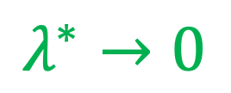
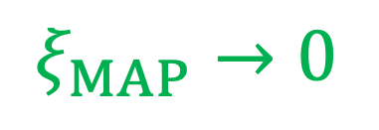

Prior as sparsifier – Hierarchical Prior
Spike and Slab Prior:
$$ξ|λ \sim 𝒩\left(0,1\right)λ+𝒩\left(0,ε^{2}\right)(1−λ)$$
$$λ \sim Ber(π)$$
Prior 2
$ξ_{MAP}→0$
$$λ^{∗}→0$$
Prior 1
0
$$ξ_{MAP}$$
$$ξ_{1}$$

Slide 23
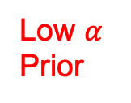

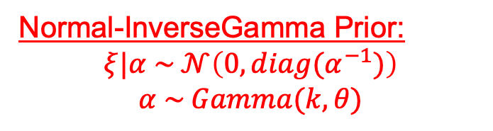

Prior as sparsifier – Hierarchical Prior
Normal-InverseGamma Prior:
$$ξ|α \sim 𝒩\left(0,{diag(α}^{−1})\right)$$
$$α \sim Gamma(k,θ)$$
High $α$ Prior
Proxy to log-uniform
$ξ_{MAP}≠0$
Low $α$ Prior
$α^{∗}$ finite
0
$$ξ_{MAP}$$
$$ξ_{1}$$

Slide 24

Prior as sparsifier – Hierarchical Prior
Normal-InverseGamma Prior:
$$ξ|α \sim 𝒩\left(0,{diag(α}^{−1})\right)$$
$$α \sim Gamma(k,θ)$$
High $α$ Prior
Proxy to log-uniform
$ξ_{MAP}→0$
Low $α$ Prior
$$α^{∗}→∞$$
0
$$ξ_{MAP}$$
$$ξ_{1}$$

Slide 25
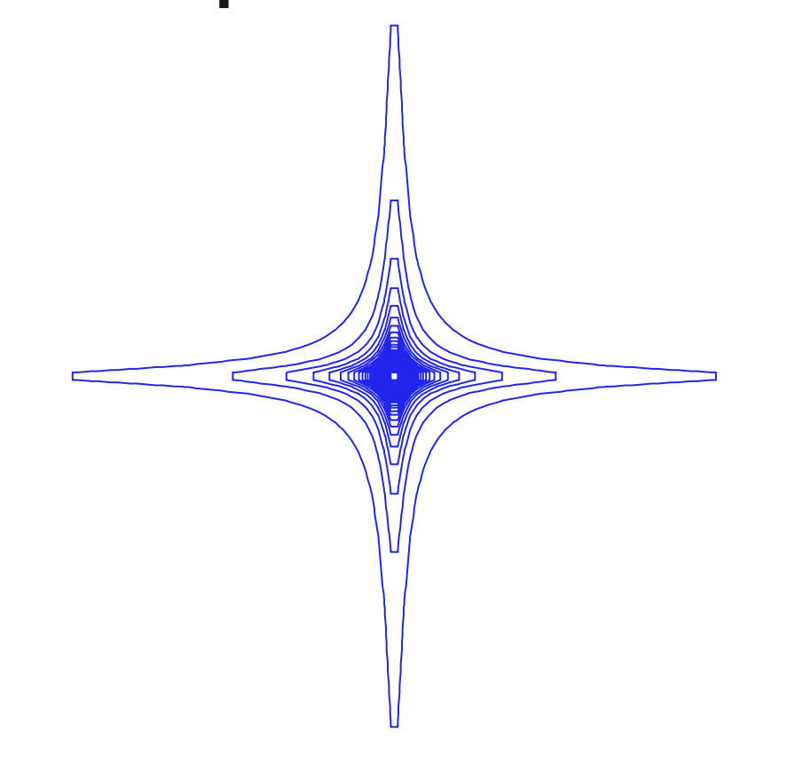
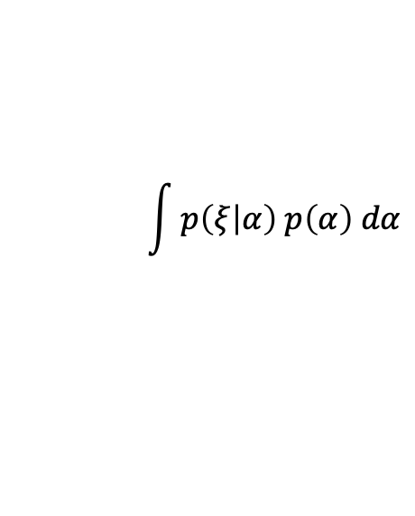
Prior as sparsifier – Hierarchical Prior
Normal-InverseGamma Prior:
$$ξ|α \sim 𝒩\left(0,{diag(α}^{−1})\right)$$
$$α \sim Gamma(k,θ)$$
High $α$ Prior
$$\int{p\left(ξ | α\right) p\left(α\right) dα}$$
True Prior = Student’s T:
Low $α$ Prior
0
$$ξ_{1}$$

Slide 26
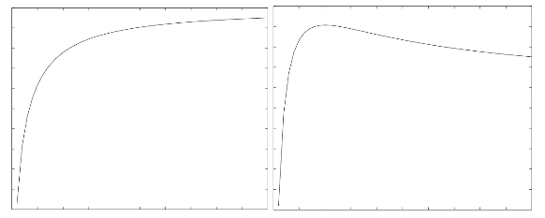
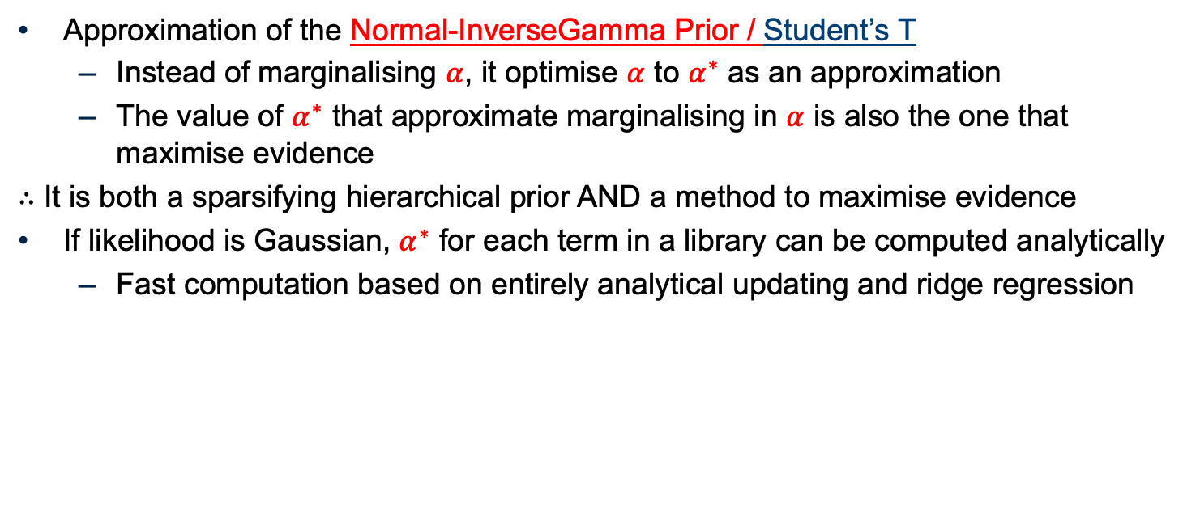



The SparseBayes/ARD Algorithm
Approximation of the Normal-InverseGamma Prior / Student’s T
Instead of marginalising $α$, it optimise $α$ to $α^{∗}$ as an approximation
The value of $α^{∗}$ that approximate marginalising in $α$ is also the one that maximise evidence
$∴$ It is both a sparsifying hierarchical prior AND a method to maximise evidence
If likelihood is Gaussian, $α^{∗}$ for each term in a library can be computed analytically
Fast computation based on entirely analytical updating and ridge regression
$α^{∗}$
Evidence($α$)
$$\ln{α}$$
$$\ln{α}$$
Notes:
This page needs more work

Slide 27
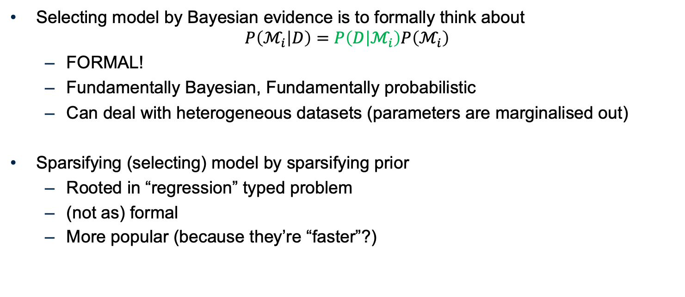
Final remark on sparsifying priors VS Bayesian evidence
Selecting model by Bayesian evidence is to formally think about
$$P\left(ℳ_{i} | D\right)=P\left(D | ℳ_{i}\right)P\left(ℳ_{i}\right)$$
FORMAL!
Fundamentally Bayesian, Fundamentally probabilistic
Can deal with heterogeneous datasets (parameters are marginalised out)
Sparsifying (selecting) model by sparsifying prior
Rooted in “regression” typed problem
(not as) formal
More popular (because they’re “faster”?)

Slide 28
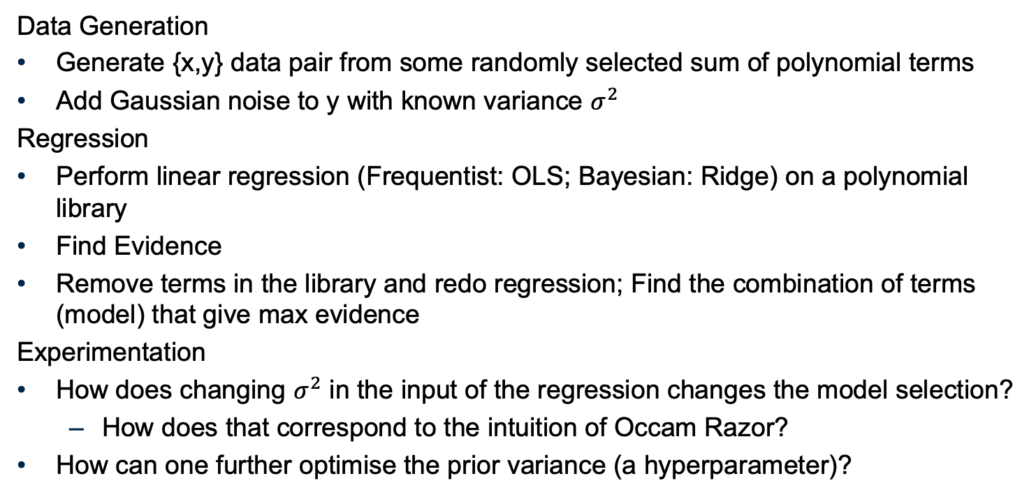
Tutorial: 1D Polynomial Regression
Data Generation
Generate {x,y} data pair from some randomly selected sum of polynomial terms
Add Gaussian noise to y with known variance $σ^{2}$
Regression
Perform linear regression (Frequentist: OLS; Bayesian: Ridge) on a polynomial library
Find Evidence
Remove terms in the library and redo regression; Find the combination of terms (model) that give max evidence
Experimentation
How does changing $σ^{2}$ in the input of the regression changes the model selection?
How does that correspond to the intuition of Occam Razor?
How can one further optimise the prior variance (a hyperparameter)?

